Slide 1
Unit 3 Process Coordination and Deadlocks

Slide 2
Background
Processes can execute concurrently
May be interrupted at any time, partially completing execution
Concurrent access to shared data may result in data inconsistency
Maintaining data consistency requires mechanisms to ensure t he orderly execution of cooperating processes
Illustration of the problem:
Suppose that we wanted to provide a solution to the consumer- producer problem that fills all the buffers.We can do so by having an integer counter that keeps track of the number of full buffers.
Initially, counter is set to 0. It is incremented by the producer after it produces a new buffer and is decremented by the consumer after it consumes a buffer

Slide 3
Producer – Consumer Problem
while (true) {
/* produce an item in next produced */
while (counter == BUFFER_SIZE) ;
/* do nothing */ buffer[in] = next_produced;
in = (in + 1) % BUFFER_SIZE;
counter++;
}
while (true) {
while (counter == 0)
; /* do nothing */ next_consumed = buffer[out];
out = (out + 1) % BUFFER_SIZE;
counter--;
/* consume the item in next consumed */
}

Slide 4
Producer – Consumer Problem
counter++ register1 = counter register1 = register1 + 1
counter = register1
counter-- register2 = counter
register2 = register2 - 1
counter = register2
Consider this execution interleaving with “count = 5” initially
S0: producer execute register1 = counter {register1 = 5}
S1: producer execute register1 = register1 + 1 {register1 = 6}
S2: consumer execute register2 = counter {register2 = 5}
S3: consumer execute register2 = register2– 1 {register2 = 4}
S4: producer execute counter = register1 {counter = 6}
S5: consumer execute counter = register2 {counter = 4}

Slide 5
Race condition
Race condition – a situation when:
several processes access the same data concurrently
the outcome of the execution depends on the order of the accesses
What is race condition? The situation where several processes access – and manipulate shared data concurrently. The final value of the shared data depends upon which process finishes last.
To prevent race conditions, concurrent processes must be synchronized.

Slide 6
The Critical Section Problem
Consider system of n processes {P₀, P₁, … ,P_{n-1}}
Each process has critical section segment of code
Process may be changing common variables, updating a table, writing a file, etc
When one process in critical section, no other is allowed to be in its critical section
Critical section problem is to design protocol to solve this

Slide 7
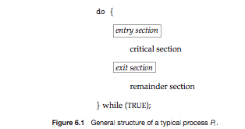
General structure of process p_{i} is
Each process
must ask to enter critical section in entry section
May follow critical section with exit section.
Then remainder section(anything else a process does beside using the critical section).

Slide 8
Critical section
A Critical Section is a code segment that accesses shared variables and has to be executed as an atomic action.
It means that in a group of cooperating processes, at a given point of time, only one process must be executing its critical section. If any other process also wants to execute its critical section, it must wait until the first one finishes

Slide 9
Race Conditions in Critical Sections
A race condition is a special condition that may occur inside a critical section.
A critical section is a section of code that is executed by multiple threads and where the sequence of execution for the threads makes a difference in the result of the concurrent execution of the critical section.
The situation where two threads compete for the same resource, where the sequence in which the resource is accessed is significant, is called race conditions. A code section that leads to race conditions is called a critical section.

Slide 10
Solution for a Critical Section Problem must satisfy the following requirements
1.Mutual Exclusion:
If a process is executing in its critical section then no other process can execute in its critical section.
2.Progress:
When no process is in a critical section, any process that requests entry to the critical section must be permitted to enter without delay.
3.Bounded wait:
There is an upper bound on the number of times a process can enter its critical section while another is waiting ( no starvation).

Slide 11
Peterson’s solution
One of the good solution for solving critical section problem
Software based solution.
Two process solution
The two processes share two variables:
int turn;
Boolean flag[2]
The variable turn indicates whose turn it is to enter the critical section
The flag array is used to indicate if a process is ready to enter the critical section. flag[i] = true implies that process P_{i} is ready!

Slide 12
Peterson’s solution
do {
flag[i] = true;
turn = j;
while (flag[j] && turn == j) do no-op;
critical section
flag[i] = false;
remainder section
} while (true);
Provable that the three CS requirement are met:
1.Mutual exclusion is preserved
P_{i} enters CS only if:
either flag[j] = false or turn = i
2.Progress requirement is satisfied
3.Bounded-waiting requirement is met
But we cannot avoid busy waiting

Slide 13
Synchronization Hardware
Any solution to the critical-section problem requires a simple tool-a lock.
Race conditions are prevented by requiring that critical regions be protected by locks.
That is, a process must acquire a lock before entering a critical section; it releases the lock when it exits the critical section.
This is illustrated in Figure

Slide 14
Synchronization Hardware
Solution to Critical-section Problem Using Locks
do {
acquire lock
critical section
release lock
remainder section
} while (true)

Slide 15
Synchronization Hardware
Many systems provide hardware support for implementing t h e critical section code.
All solutions below based on idea of locking
Protecting critical regions via locks
Modern machines provide special atomic hardware instructions
Atomic = non-interruptible
test_and_set instruction
test memory word and set value
compare_and_swap instruction
swap contents of two memory words

Slide 16
Synchronization Hardware
test_and_set Instruction
boolean test_and_set(boolean &lock)
{
boolean temp = lock;
lock= true;
return temp;
}

Slide 17
Shared boolean variable lock, initialized to FALSE
Solution:
do {
while ( TestAndSet (&lock )) ;
// critical section
lock = FALSE;
// remainder section
} while (TRUE);

Slide 18
Synchronization Hardware
compare_and_swap Instruction
void Swap (boolean *a, boolean *b)
{
boolean temp = *a;
*a = *b;
*b = temp:
}

Slide 19
Shared Boolean variable lock initialized to FALSE; Each process has a local Boolean variable key
Solution:
do {
key =TRUE;
while ( key == TRUE)
Swap (&lock, &key );
// critical section
lock = FALSE;
// remainder section
} while (TRUE);

Slide 20
Semaphore
Synchronization tool that does not require busy waiting
Semaphore S – integer variable
Two standard operations modify S: wait() and signal()
Originally called P() and V()
Less complicated
Can only be accessed via two indivisible (atomic) operations
wait (S) {
while S <= 0
; // no-op
S--;
}
signal (S) {
S++;
}

Slide 21
Semaphore as General Synchronization Tool
Counting semaphore – integer value can range over an unrestricted domain
Binary semaphore – integer value can range only between 0 and 1; can be simpler to implement
Also known as mutex locks
Can implement a counting semaphore S as a binary semaphore
Provides mutual exclusion
Semaphore mutex; // initialized to 1
do {
wait (mutex);
// Critical Section
signal (mutex);
// remainder section
} while (TRUE);

Slide 22
Semaphore Implementation
Must guarantee that no two processes can execute wait () and signal () on the same semaphore at the same time
Thus, implementation becomes the critical section problem where the wait and signal code are placed in the crtical section
Could now have busy waiting in critical section implementation
But implementation code is short
Little busy waiting if critical section rarely occupied
Note that applications may spend lots of time in critical sections and therefore this is not a good solution

Slide 23
Classic Problems of Synchronization
Classical problems used to test newly-proposed synchronization schemes
Readers and Writers Problem
Bounded-Buffer Problem (Producer – Consumer Problem)
Dining-Philosophers Problem

Slide 24
Producer-Consumer Problem
Producer
adds items into the buffer
It has to stop when the buffer is full
It should not allow the consumer to consume while producing
Consumer
Consumes an item from the buffer
It cannot consume from an empty buffer
It should not allow the producer to produce while consumer is consuming

Slide 25
Producer-Consumer Problem
Solution
One semaphore to make these two process mutual exclusive
One semaphore to maintain number of item in buffer
One semaphore to maintain number of empty places in buffer

Slide 26
Bounded Buffer Problem (Cont.)
The structure of the producer process
do {
// produce an item in nextp wait (mutex);
wait (empty);
// add the item to the buffer
signal (full);
signal (mutex);
} while (TRUE);

Slide 27
Bounded Buffer Problem (Cont.)
The structure of the consumer process
do {
wait (mutex); wait (full);
// remove an item from buffer to nextc signal (empty);
signal (mutex);
// consume the item in nextc
} while (TRUE);

Slide 28
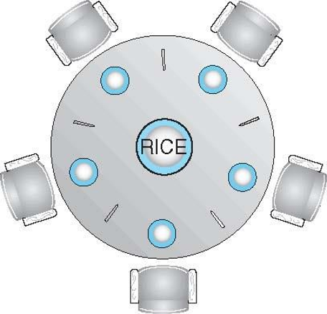
Dining-Philosophers Problem
Philosophers spend their lives thinking and eating
Don’t interact with their neighbors, occasionally try to pick up 2 chopsticks (one at a time) to eat from bowl
Need both to eat, then release both when done
In the case of 5 philosophers
Shared data
Bowl of rice (data set)
Semaphore chopstick [5] initialized to 1

Slide 29
Dining-Philosophers Problem
Solution
Take the left fork and then acquire the right fork
If you don’t get the left fork then wait. After acquiring l e f t, check whether you get right, else wait for right fork

Slide 30
Dining-Philosophers Problem Algorithm
The structure of Philosopher i:
do {
wait ( chopstick[i] );
wait ( chopStick[ (i + 1) % 5] );
// eat
signal ( chopstick[i] );
signal (chopstick[ (i + 1) % 5] );
// think
} while (TRUE);

Slide 31
Monitors
A monitor – is an ADT that provides a convenient and effective mechanism for process synchronization
A Programming language construct that supports controlled access to shared data
Monitor is a software module that encapsulates:
Shared data structures
Procedure that operate on the shared data
Synchronization between concurrent process that include those procedures
Monitor protects the data from unstructured access
Guarantees only access data through procedures

Slide 32
Monitors
Only one process at a time may be active within the mon i tor
A lock guards shared data
Hence, the programmer does not need to code this constraint
monitor monitor-name
{
// shared variable declarations
function P1 (…) { … }
…
function Pn (…) {……}
initialization_code (…) { … }
}

Slide 33
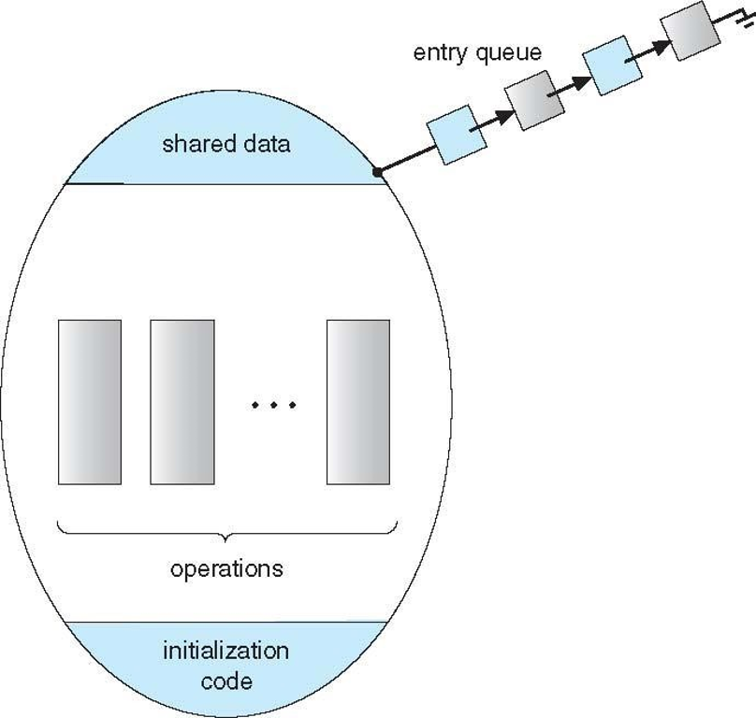
Schematic view of a Monitor

Slide 34
Monitors
Queues can be associated with conditions
Two operations are allowed on a condition variable x.
Now suppose x.signal() operation is invoked by process P, there is a suspended process Q associated with condition x
A compromise between the two choices can be adopted I in the programming construct
Signal and wait: P either waits until Q leaves the monitor
Signal and continue: Q either waits until P leaves the monitor

Slide 35
Difference Between Semaphore and Monitor
BASIS FOR COMPARISON | SEMAPHORE | MONITOR
Basic | Semaphores is an integer variable S. | Monitor is an abstract data type.
Action | The value of Semaphore S indicates the number of shared resources availabe in the system | The Monitor type contains shared variables and the set of procedures that operate on the shared variable.
Access | When any process access the shared resources it perform wait() operation on S and when it releases the shared resources it performs signal() operation on S. | When any process wants to access the shared variables in the monitor, it needs to access it through the procedures.
Condition variable | Semaphore does not have condition variables. | Monitor has condition variables.

Slide 36
Deadlocks

Slide 37
System Model
System consists of finite number of resources which has to be shared among the competing process.
Resource types R₁, R₂, . . ., R_{m}
CPU cycles, files, memory space, I/O devices, etc
Each resource type R_{i} has W_{i} instances
Type: CPU
2 instances - CPU1, CPU2
Type: Printer
3 instances - printer1, printer2, printer3
Each process utilizes a resource as follows:
Request resource
Use resource
Release resource

Slide 38
What is Deadlock?
Deadlock is a situation where a set of processes are blocked because each process is holding a resource and waiting for another resource acquired by some other process.
Resources may be physical (cpu cycles, printer, tape drive..) / logical (semaphores, monitors, files…)
Deadlock may also involve same/ different resource type

Slide 39
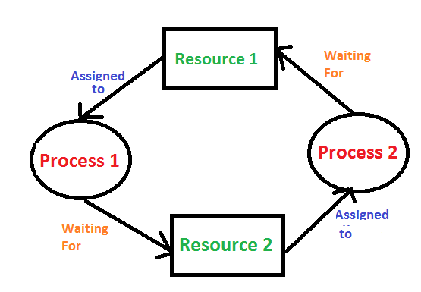
Deadlock Example

Slide 40
Deadlock Characterization
Necessary Conditions that causes deadlock
Mutual exclusion : only one process at a time can use a resource
Hold and wait: a process holding at least one resource is waiting to acquire additional resources held by other processes
No preemption: a resource can be released only voluntarily by the process holding it, after that process has completed its task
Circular wait: there exists a set {P₀, P₁, …, P_{n}} of waiting processes such that P₀ is waiting for a resource that is held by P₁, P₁ is waiting for a resource that is held by P₂, …, P_{n-1} is waiting for a resource that is held by P_{n}, and P_{n} is waiting for a resource that is held by P₀.
Deadlock may arise if 4 conditions hold simultaneously in a system.

Slide 41
Deadlock Characterization
Resource-Allocation Graph
Useful tool to describe and analyze deadlocks
Set of vertices V
Set of edges E
V is partitioned into two types:
P = {P₁, P₂, …, P_{n}}, the set of all the processes in the system
R = {R₁, R₂, …, R_{m}}, the set of all resource types in the system
Request edge – directed edge P_{i} → R_{j}
Means P_{i} has requested (an instance of) R_{j} and now is waiting for it
Assignment edge – directed edge R_{j} → P_{i}
Means an instance of R_{j} has been assigned to P_{i}

Slide 42
Deadlock Characterization
Resource-Allocation Graph – Pictorial Representation
Process
Resource Type (with 4 dots for 4 instances in this specific example)
P_{i} requests instance of R_{j}
P_{i} is holding an instance of R_{j}
P_{i}
R_{j}
P_{i}
R_{j}

Slide 43
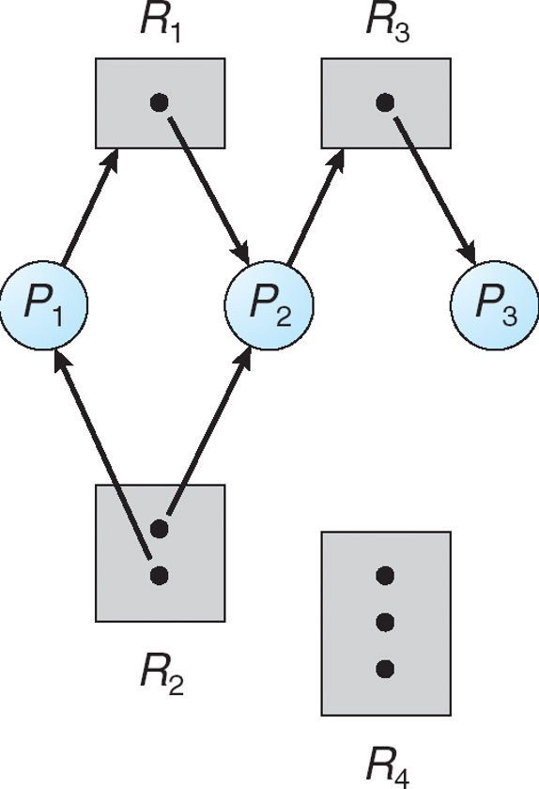
Resource-Allocation Graph – Example

Slide 44
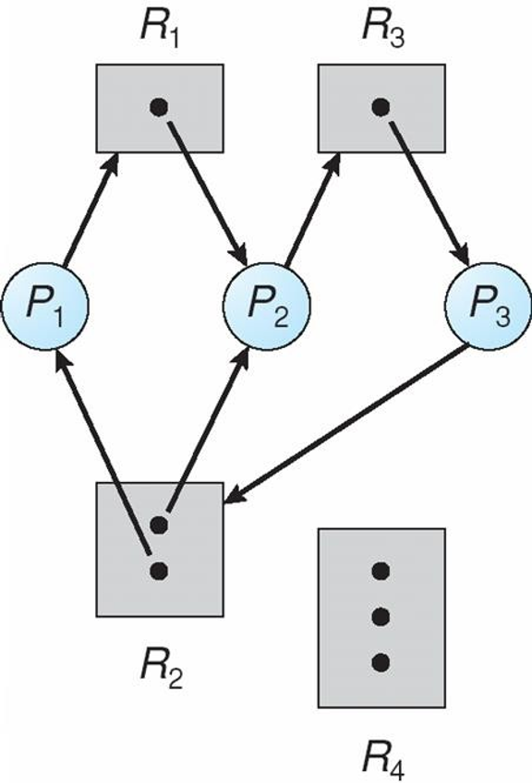
Resource-Allocation Graph – Deadlocked State

Slide 45
Basic Fact
If graph contains no cycles => no deadlock
If graph contains a cycle =>
if only one instance per resource type, then deadlock
if several instances per resource type, possibility of deadlock

Slide 46
Methods for Handling Deadlocks
Three ways to handle deadlocks:
Ensure that the system will never enter a deadlock state:
Deadlock prevention
Deadlock avoidance
Allow the system to enter a deadlock state and then recover
Ignore the problem and pretend that deadlocks never occur in the system
Used by most operating systems, including UNIX
One reason: Handling deadlocks can be computationally expensive

Slide 47
Deadlock Prevention
Key idea: Restrain the ways request for resources can be made
Recall, all 4 necessary conditions must occur for a deadlock to happen
Mutual Exclusion
Hold and Wait
No preemption
Circular Wait
If we ensure at least one condition is not met, we prevent a deadlock

Slide 48
Prevention – contd..
Mutual Exclusion – not required for sharable resources; must hold for non sharable resources
Hold and Wait – must guarantee that whenever a process requests a resource, it does not hold any other resources

Slide 49
Prevention – contd..
No Preemption –
If a process that is holding some resources requests another resource that cannot be immediately allocated to it, then all resources currently being held are released
Preempted resources are added to the list of resources for which the process is waiting
Process will be restarted only when it can regain its o ld resources, as well as the new ones that it is requesting
Circular Wait – impose a total ordering of all resource types, and require that each process requests resources in an increasing order of enumeration

Slide 50
Deadlock Avoidance
Idea: Require that the system has some additional a priori information about how resources will be used
Simplest and most useful model requires that each process declare the maximum number of resources of each type that it may need
The deadlock-avoidance algorithm dynamically examines t he resource-allocation state to ensure that there can never be a circular-wait condition
Resource-allocation state is defined by:
number of available resources
number of allocated resources
maximum resource demands of the processes

Slide 51
Safe State
When a process requests an available resource, system must decide if immediate allocation leaves the system in a safe state
System is in safe state if there exists a sequence <P₁, P₂, …, P_{n}> of ALL the processes in the systems such that for each P_{i}, the resources that P_{i} can still request can be satisfied by currently available resources + resources held by all the P_{j}, with j < I.
That is:
If P_{i} resource needs are not immediately available, then P_{i} can wait until all P_{j} have finished
When P_{j} is finished, P_{i} can obtain needed resources, execute, return allocated resources, and terminate
When P_{i} terminates, P_{i +1} can obtain its needed resources, and so on

Slide 52
Basic Facts
If a system is in safe state => no deadlocks
If a system is in unsafe state =>possibility of deadlock
Avoidance => ensure that a system will never enter a n unsafe state.

Slide 53
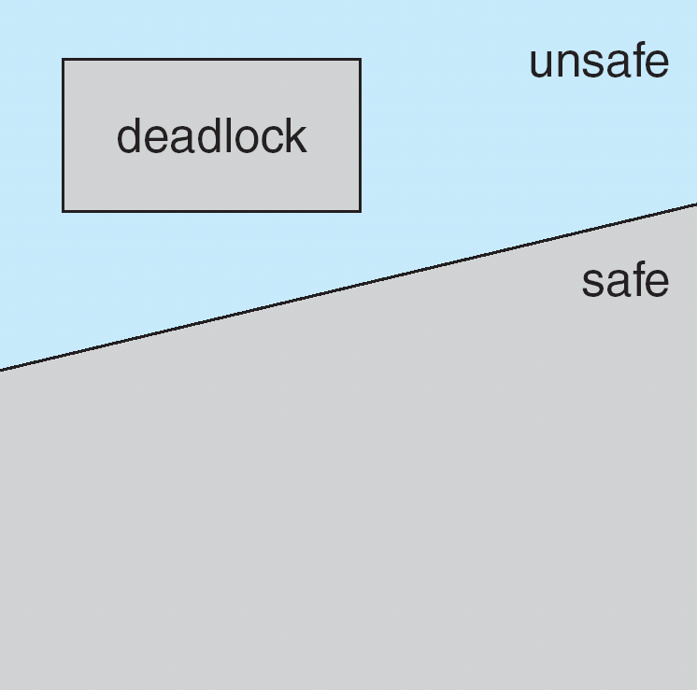
Safe, Unsafe, Deadlock State
.

Slide 54
Avoidance algorithms
Single instance of a resource type
Use a resource-allocation graph
Multiple instances of a resource type
Use the banker’s algorithm

Slide 55
Resource-Allocation Graph Scheme
Claim edge P_{i} R_{j} indicated that process P_{j} may request resource R_{j}; represented by a dashed line
Claim edge converts to request edge when a process requests a resource
Request edge converted to an assignment edge when the resource is allocated to the process
When a resource is released by a process, assignment edge reconverts to a claim edge
Resources must be claimed a priori in the system

Slide 56
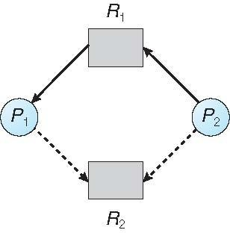
Resource-Allocation Graph
.

Slide 57
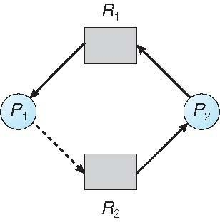
Unsafe State In Resource-Allocation Graph
.

Slide 58
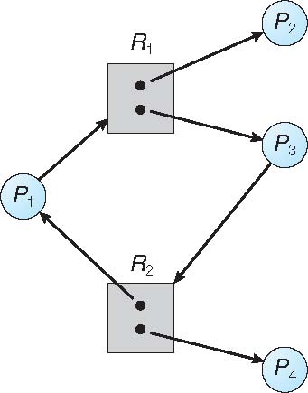
Graph With A Cycle But No Deadlock
Notes:
58

Slide 59
Resource-Allocation Graph Algorithm
Suppose that process P_{i} requests a resource R_{j}
The request can be granted only if converting the request edge to an assignment edge does not result in the formation of a cycle in the resource allocation graph

Slide 60
Banker’s Algorithm
Multiple instances
Each process must a priori claim maximum use
When a process requests a resource it may have to wait
When a process gets all its resources it must return the m in a finite amount of time

Slide 61
Data Structures for the Banker’s Algorithm
Let n = number of processes, and m = number of resources types.
Available: Vector of length m. If available [j] = k, there are k instances of resource type R_{j} available
Max: n x m matrix. If Max [i,j] = k, then process P_{i} may request at most k instances of resource type R_{j}
Allocation: n x m matrix. If Allocation[i,j] = k then P_{i} is currently allocated k instances of R_{j}
Need: n x m matrix. If Need [i,j] = k, then P_{i} may need k more instances of R_{j} to complete its task
Need [i,j] = Max[i,j] – Allocation [i,j]

Slide 62
Safety Algorithm
Let Wo rk and Finish be vectors of length m and n,
respectively. Initialize:
Work = Available
Finish [i] = false for i = 0, 1, …, n- 1
Find an i such that both:
Finish [i] = false
Need_{i} = Work
If no such i exists, go to step 4
Work = Work + Allocation_{i}
Finish[i] = true
go to step 2
If Finish [i] == true for all i, then tSShe system is in a safe state

Slide 63
Resource-Request Algorithm for Process P_{i}
Request = request vector for process P_{i}. If Request_{i} [j] = k then process P_{i} wants k instances of resource type R_{j}
If Request_{i} <=Need_{i} go to step 2. Otherwise, raise error
condition, since process has exceeded its maximum claim
If Request_{i} <= Available, go to step 3. Otherwise P_{i} must wait, since resources are not available
Pretend to allocate requested resources to P_{i} by modifying the state as follows:
Available = Available – Request; Allocation_{i} = Allocation_{i} + Request_{i}; Need_{i} = Need_{i} – Request_{i};
If safe => the resources are allocated to Pi
If unsafe =>Pi must wait, and the old resource-allocation state is restored

Slide 64
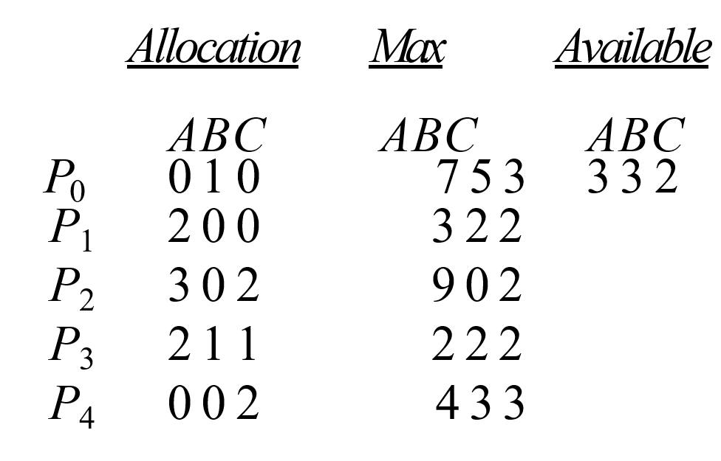
Example of Banker’s Algorithm
5 processes P₀ through P₄; 3 resource types:
A (10 instances), B (5instances), and C (7 instances)
Snapshot at time T₀:

Slide 65
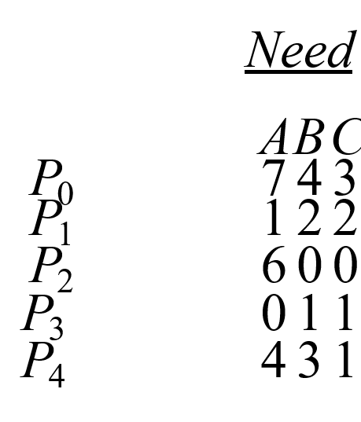
Example (Cont.)
The content of the matrix Need is defined to be Max – Allocation
The system is in a safe state since the sequence
< P₁, P₃, P₄, P₂, P₀> satisfies safety criteria

Slide 66
Deadlock Detection
Allow system to enter deadlock state
Detection algorithm
Recovery scheme

Slide 67
Single Instance of Each Resource Type
Maintain wait-for graph
Nodes are processes
P_{i} => P_{j} if P_{i} is waiting for P_{j}
Periodically invoke an algorithm that searches for a cycle i n the graph. If there is a cycle, there exists a deadlock
An algorithm to detect a cycle in a graph requires an order of n² operations, where n is the number of vertices in the graph

Slide 68
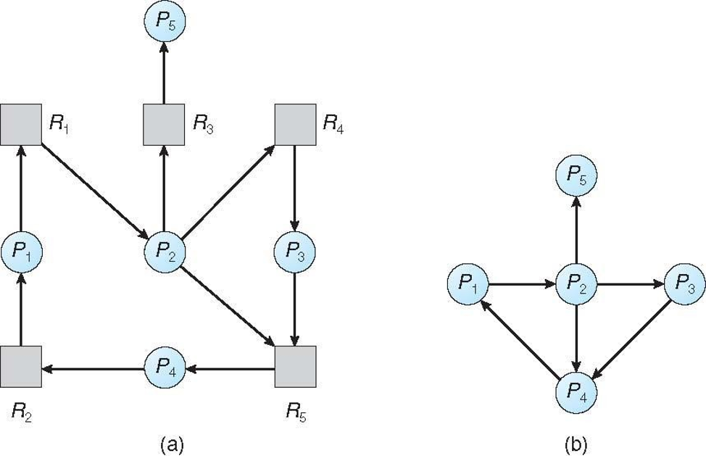
Resource-Allocation Graph and Wait-for Graph
Resource-Allocation Graph
Resource-Allocation Graph

Slide 69
Several Instances of a Resource Type
Available: A vector of length m indicates the number o f available resources of each type.
Allocation: An n x m matrix defines the number of resources of each type currently allocated to each process.
Request: An n x m matrix indicates the current request of each process.
If Request [i][j] = k, then process P_{i} is requesting k more instances of resource type.R_{j}.

Slide 70
Detection Algorithm
Let Work and Finish be vectors of length m and n, respectively Initialize:
Work = Available
For i =1,2, …, n, if Allocation_{i}  0, then
Finish[i] = false; otherwise, Finish[i] =true
Find an index i such that both:
Finish[i] ==false
Request_{i} <= Work
If no such i exists, go to step 4

Slide 71
Detection Algorithm (Cont.)
3.Work = Work + Allocation_{i}
Finish[i] = true go to step 2
4. If Finish[i] == false, for some i, 1 <= i <=n, then the system is in deadlock state.
Moreover, if Finish[i] == false, then P_{i} is
deadlocked
Algorithm requires an order of O(m x n²⁾ operations to detect whether the system is in deadlocked state

Slide 72
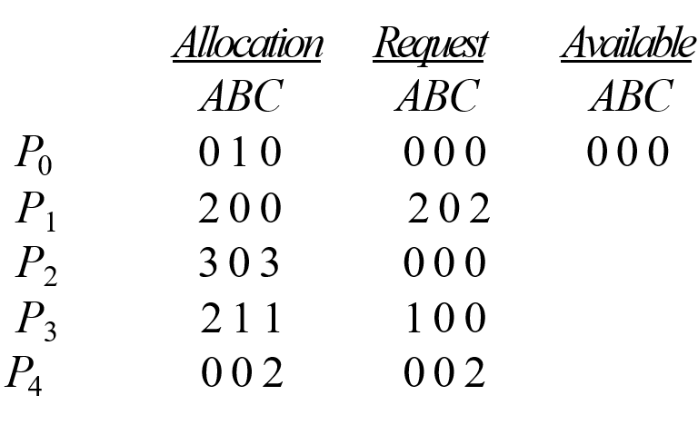
Example of Detection Algorithm
Five processes P₀ through P₄; three resource types A (7 instances), B (2 instances), and C (6 instances)
Snapshot at time T₀:
Sequence <P₀, P₂, P₃, P₁, P₄> will result in Finish[i] = true for all i

Slide 73
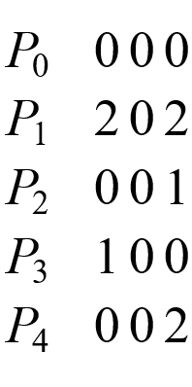
Example (Cont.)
P₂ requests an additional instance of type C
Request A B C
State of system?
Can reclaim resources held by process P₀, but insufficient resources to fulfill other processes; requests
Deadlock exists, consisting of processes P₁, P₂, P₃, and P₄

Slide 74
Detection-Algorithm Usage
When, and how often, to invoke depends on:
How often a deadlock is likely to occur?
How many processes will need to be rolled back?
one for each disjoint cycle
If detection algorithm is invoked arbitrarily, there may be many cycles in the resource graph and so we would not be able to tell which of the many deadlocked processes “caused” the deadlock.

Slide 75
Recovery from Deadlock: Process Termination
Abort all deadlocked processes
Abort one process at a time until the deadlock cycle is eliminated
In which order should we choose to abort?
Priority of the process
How long process has computed, and how much longer to completion
Resources, the process has used
Resources required for the process to complete
How many processes will need to be terminated
Is process interactive or batch?

Slide 76
Recovery from Deadlock: Resource Preemption
Selecting a victim – minimize cost
Rollback – return to some safe state, restart process for that state
Starvation – same process may always be picked as victim, include number of rollback in cost factor

